Slide 1
Software Engineering
The Software Process

Slide 2
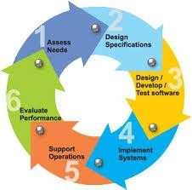
Definition of Software Process
Software Process:
A framework for the activities, actions, and tasks that
are required to build high-quality software.
SP defines the approach that is taken as software is engineered.
Is not equal to software engineering, which also encompasses technologies that populate the process– technical methods and automated tools.
Process Model :
A Process Model describes the sequence of phases for the entire lifetime of a product. Therefore it is sometimes also called Product Life Cycle.
This covers everything from the initial commercial idea until the final de-installation or disassembling of the product after its use.
3

Slide 3
What / who / why is Process Models?
What: Go through a series of predictable steps--- a road map that helps you create a timely, high-quality results.
Who: Software engineers and their managers, clients also. People
adapt the process to their needs and follow it.
Why: Provides stability, control, and organization to an activity that can if left uncontrolled, become quite chaotic. However, modern software engineering approaches must be agile and demand ONLY those activities, controls and work products that are appropriate.
What Work products: Programs, documents, and data
What are the steps: The process you adopt depends on the software that you are building. One process might be good for aircraft avionic system, while an entirely different process would be used for website creation.
How to ensure right: A number of software process assessment mechanisms that enable us to determine the maturity of the software process. However, the quality, timeliness and long-term viability of the software are the best indicators of the efficacy of the process you use.
4

Slide 4
A Generic Process Model
As we discussed before, a generic process framework for software engineering defines five framework activities- communication, planning, modeling, construction, and deployment.
In addition, a set of umbrella activities- project tracking and control, risk management, quality assurance, configuration management, technical reviews, and others are applied throughout the process.

Slide 5
A Generic Process Model
Communication : This activity involves heavy communication with customers and other stakeholders in order to gather requirements and other related activities.
Planning : Here a plan to be followed will be created which will describe the technical tasks to be conducted, risks, required resources, work schedule etc.
Modeling : A model will be created to better understand the
requirements and design to achieve these requirements.
Construction : Here the code will be generated and tested.
Deployment : Here, a complete or partially complete version of the software is represented to the customers to evaluate and they give feedbacks based on the evaluation.

Slide 6
The SEI Process Models
The SEI CMMIs are the best-known process models for software engineering
SEI: Software Engineering Institute
CMMI: Capability Maturity Models Integrated
See:
http://www.sei.cmu.edu/cmmi/

Slide 7
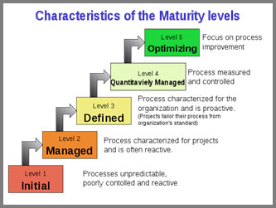
CMMI: Capability Maturity Models Integrated

Slide 8
Software Process Models
Waterfall model (Royce, 1970)
Prototyping
Throwaway
Evolutionary
Incremental development
Iterative
Spiral model (Boehm, 1988)

Slide 9
The Waterfall Model
Requirements
Definition
System and
Software design
Programming
and Unit Testing
Integration and
System Testing
Operation and
Maintenance

Slide 10
Observations
The following phase should not start until the previous phase has finished.
In practice,
Phases overlap
May return to a previous phase
Still widely used, especially on very large projects

Slide 11
The Waterfall Approach
The Waterfall Model requires that we (attempt to):
specify the requirements completely, consistently, correctly, and unambiguously on the first attempt
design the software completely and correctly on the first attempt
write all of the software interfaces and internal details correctly on the first attempt
integrate the components in one large step
do system testing and acceptance testing at the end
The linear waterfall model is a one-pass process

Slide 12
Requirements Analysis and Definition
The system's services, constraints and goals are established by consultation with system users. They are then defined in a manner that is understandable by both users and development staff.
This phase can be divided into:
❖ Feasibility study (often carried out separately)
❖ Requirements analysis
❖ Requirements definition
❖ Requirements specification

Slide 13
System and Software Design
System design: Partition the requirements to hardware or software systems. Establishes an overall system architecture
Software design: Represent the software system functions in a form that can be transformed into one or more executable programs
❖ Unified Modeling Language (UML)

Slide 14
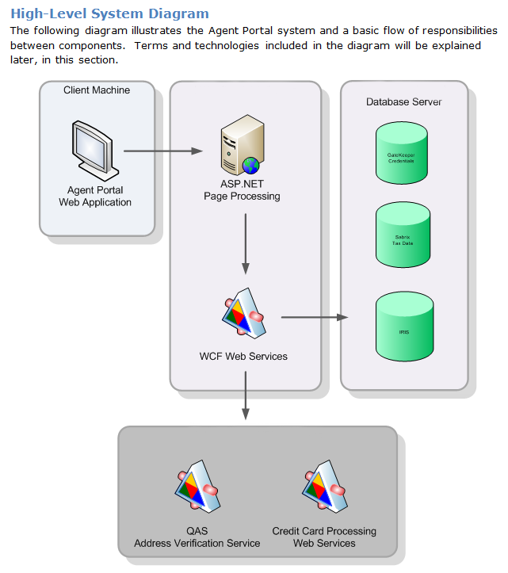

Slide 15
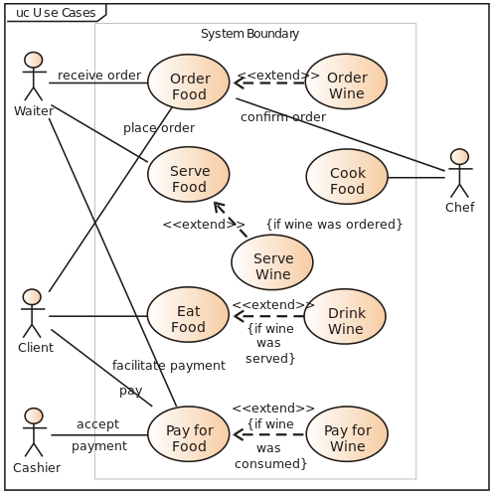

Slide 16
Programming and Unit Testing
The software design is realized as a set of programs or program units. (Written specifically, acquired from elsewhere, or modified.)
Individual components are tested against specifications.

Slide 17
Integration and System Testing
The individual program units are:
❖ integrated and tested as a complete system
❖ tested against the requirements as specified
❖ delivered to the client

Slide 18
Operation and Maintenance
❖ Operation: The system is put into practical use.
❖ Maintenance: Errors and problems are identified and fixed.
❖ Evolution: The system evolves over time as requirements change, to add new functions or adapt the technical environment.
❖ Phase out: The system is withdrawn from service.

Slide 19
Advantages of waterfall model:
This model is simple and easy to understand and use.
It is easy to manage due to the rigidity of the model – each phase has specific deliverables and a review process.
In this model phases are processed and completed one at a time. Phases do not overlap.
Waterfall model works well for smaller projects where requirements are very well understood.
Develop requirements before design
Design before writing code
Write code before integrating it
Test programs after integrating them
Have milestone reviews

Slide 20
Disadvantages of waterfall model
Once an application is in the testing stage, it is very difficult to go back and change something that was not well-thought out in the concept stage.
No working software is produced until late during the life cycle.
High amounts of risk and uncertainty.
Not a good model for complex and object-oriented projects.
Poor model for long and ongoing projects.
Not suitable for the projects where requirements are at a moderate to high risk of changing.

Slide 21
When to use the waterfall model:
This model is used only when the requirements are very well known, clear and fixed.
Product definition is stable.
Technology is understood.
There are no ambiguous requirements
Ample resources with required expertise are available freely
The project is short.

Slide 22
Some Realities of Software Development
1. Requirements always change because of:
changing customer desires and user needs
initial requirements analysis inadequate
understandings and insights gained through experience
changing technology
changing competitive situation
personnel turnover: engineering, management, marketing, customer
2. The design is never right the first time
design is a creative, problem solving process
3. Frequent demonstrations of progress and early warning of problems are desirable

Slide 23
Discussion of the Waterfall Model
Advantages:
Identifies systems requirements long before programming begins.
Only appropriate when the requirements are well-understood
Disadvantages:
Takes long time to deliver since developing requirements.
Difficult to adapt to changing requirements
- Each stage in the process reveals new understanding of the previous stages, that requires the earlier stages to be revised.

Slide 24
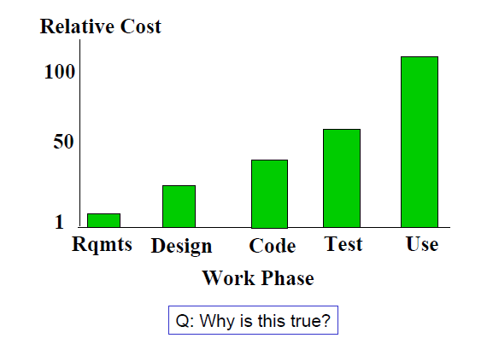
Relative Cost to Fix a Software Defect

Slide 25
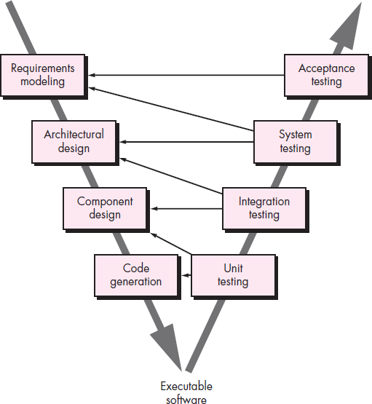
The V-Model

Slide 26
The V-Model(Cont..)
The V - model is SDLC model where execution of processes happens in a sequential manner in V-shape.
It is also known as Verification and Validation model.
V - Model is an extension of the waterfall model and is based on association of a testing phase for each corresponding development stage. This means that for every single phase in the development cycle there is a directly associated testing phase.
This is a highly disciplined model and next phase starts only after completion of the previous phase.

Slide 27
The V-Model(Cont..)
A variation of waterfall model depicts the relationship of quality assurance actions to the actions associated with communication, modeling and early code construction activates.
Team first moves down the left side of the V to refine the problem requirements. Once code is generated, the team moves up the right side of the V, performing a series of tests that validate each of the models created as the team moved down the left side.

Slide 28
Prototyping
Requirements
Design
Design
Implementation
Implementation
Testing
Testing
Maintenance

Slide 29
Observations
Used for requirements elicitation (practice of collecting the requirements ) and validation
A “working” model (prototype) of the final system is developed during requirements
The system evolves by adding new features as they are proposed by customer.
Is an iterative process
Prototype can be thrown away or evolved into the final system (evolutionary prototyping)

Slide 30
Advantages of Prototype model:
Users are actively involved in the development
Since in this methodology a working model of the system is provided, the users get a better understanding of the system being developed.
Errors can be detected much earlier.
Quicker user feedback is available leading to better solutions.
Missing functionality can be identified easily
Confusing or difficult functions can be identified Requirements validation, Quick implementation of, incomplete, but functional, application.

Slide 31
Disadvantages of Prototype model:
Leads to implementing and then repairing way of building systems.
Practically, this methodology may increase the complexity of the system as scope of the system may expand beyond original plans.
Incomplete application may cause application not to be used as the full system was designed Incomplete or inadequate problem analysis.
Lack of process visibility
Systems are often poorly structured
Special skills (e.g. in languages for rapid prototyping) may be required

Slide 32
When to use Prototype model
Prototype model should be used when the desired system needs to have a lot of interaction with the end users.
Typically, online systems, web interfaces have a very high amount of interaction with end users, are best suited for Prototype model. It might take a while for a system to be built that allows ease of use and needs minimal training for the end user.
Prototyping ensures that the end users constantly work with the system and provide a feedback which is incorporated in the prototype to result in a useable system. They are excellent for designing good human computer interface systems.
For small or medium-size interactive systems
For parts of large systems (e.g. the user interface)

Slide 33
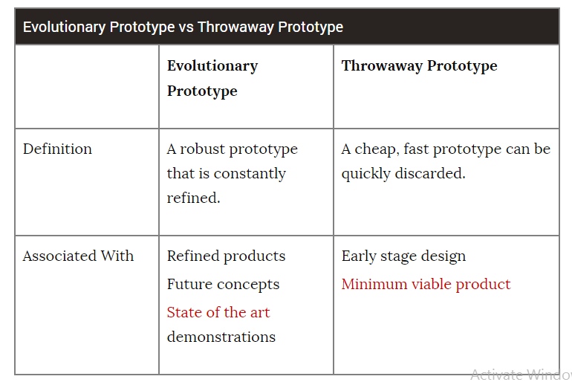

Slide 34
Evolutionary development
Exploratory development
Objective is to work with customers and to evolve a final system from an initial outline specification.
The system evolves by adding new features as they are proposed by customer.

Slide 35
Evolutionary development
Rapid prototyping
Objective is to understand the system requirements.
Develop “quick and dirty” system in short time;
Expose to user comment & feedback;
Refine;
Repeat until adequate system developed.
Particularly suitable where:
detailed requirements not possible;
powerful development tools (CASE) available

Slide 36
Evolutionary development
Concurrent
Activities
Initial
Version
Requirements
Outline
Description
Intermediate
Versions
Design
Implementation
Final
Version

Slide 37
Evolutionary development
Evaluation
Requirements
Implementation
(prototype)
Design

Slide 38
Process iteration
Modern development processes take iteration as a fundamental concept.
System requirements ALWAYS evolve during the course of a project; so process iteration where earlier stages are reworked is always part of the process for large systems.
Iteration can be applied to any of the generic process models.
Two (related) approaches:
Incremental development
Spiral development

Slide 39
Incremental development
System is not a single delivery; the development and delivery broken down into increments delivering part of the required functionality.
User requirements are prioritized and the highest priority requirements are included in early increments.
Once the development of an increment is started,
the requirements are frozen though requirements
for later increments can continue to evolve.

Slide 40
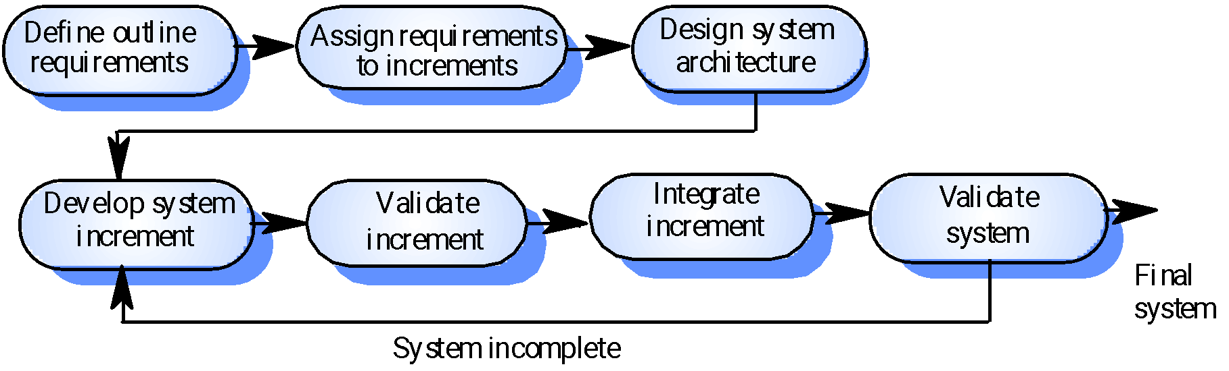
Incremental development

Slide 41
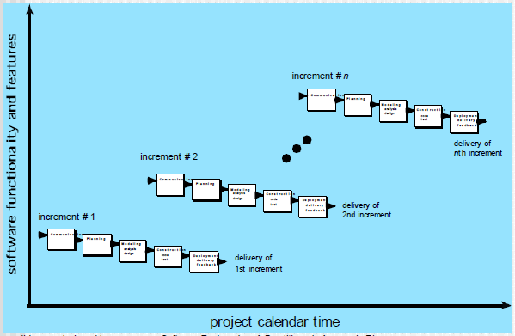
The Incremental Model

Slide 42
Observations
Development and delivery is broken down into increments with each increment delivering part of the required functionality.
User requirements are prioritised and the highest priority requirements are included in early increments.
Is an iterative process

Slide 43
Advantages of Incremental model:
Customer value can be delivered with each increment so system functionality is available earlier.
Early increments act as a prototype to help elicit requirements for later increments
Lower risk of overall project failure
The highest priority system services tend to receive the most testing
Generates working software quickly and early during the software life cycle.
This model is more flexible – less costly to change scope and requirements.
It is easier to test and debug during a smaller iteration.
In this model customer can respond to each built.
Lowers initial delivery cost.
Easier to manage risk because risky pieces are identified and handled during it’d iteration.

Slide 44
Disadvantages of Incremental model:
Needs good planning and design.
Needs a clear and complete definition of the whole system before it can be broken down and built incrementally.
Total cost is higher than waterfall.
The process is not visible.
Managers need regular deliverables to measure progress. If systems are developed quickly, it is not cost-effective to produce documents that reflect every version of the system.
System structure tends to degrade as new increments are added.
Unless time and money is spent on refactoring to improve the software, regular change tends to corrupt its structure. Incorporating further software changes becomes increasingly difficult and costly.

Slide 45
When to use the Incremental model
This model can be used when the requirements of the complete system are clearly defined and understood.
Major requirements must be defined; however, some details can evolve with time.
There is a need to get a product to the market early.
A new technology is being used
Resources with needed skill set are not available
There are some high risk features and goals.

Slide 46
Spiral Model
The spiral model is a risk-driven process model generator for software projects. Based on the unique risk patterns of a given project, the spiral model guides a team to adopt elements of one or more process models, such as incremental, waterfall, or evolutionary prototyping.
This model was first described by Barry Boehm in his 1986 paper "A Spiral Model of Software Development and Enhancement".

Slide 47
Spiral development
Process is represented as a spiral rather than as a sequence of activities with backtracking.
Each loop in the spiral represents a phase in the process.
No fixed phases such as specification or design – loops in the spiral are chosen depending on what is required.
Risks are explicitly assessed and resolved throughout the process.

Slide 48
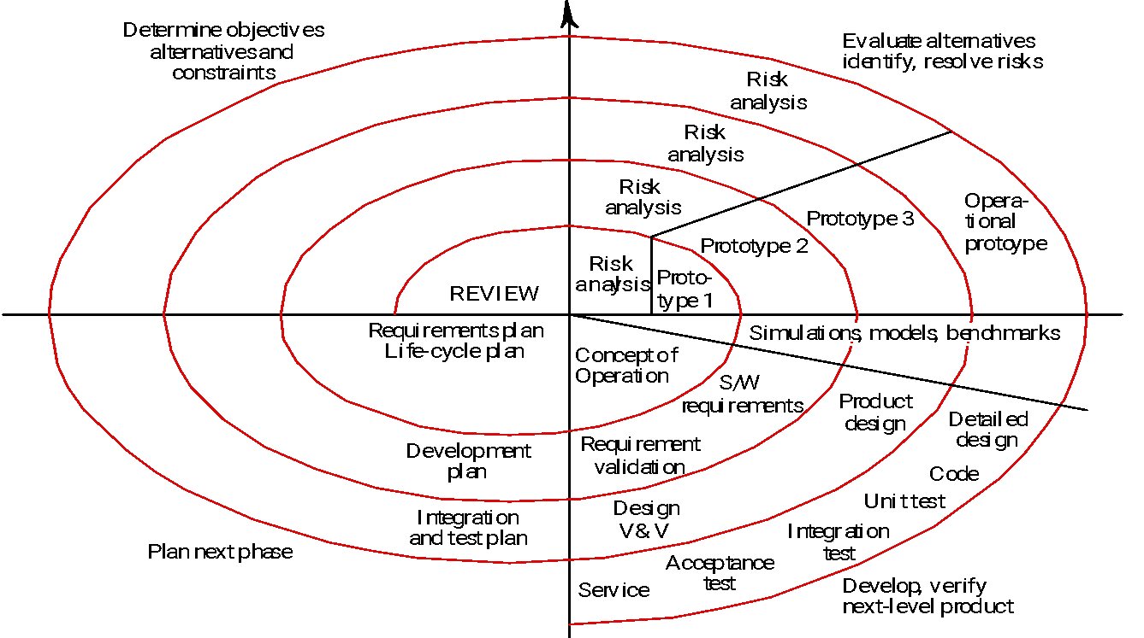
Spiral model of the software process

Slide 49
Spiral model sectors
Objective setting
• Specific objectives for the phase are identified
Risk assessment and reduction
• Risks are assessed and activities put in place to reduce key risks
Development and validation
• A development model for the system is chosen which can be any of the generic models
Planning
• The project is reviewed and next phase of the spiral is planned

Slide 50
Observations
Process is represented as a spiral rather than as a sequence of activities with backtracking
Each loop in the spiral represents a phase in the process.
No fixed phases such as specification or design -- loops in the spiral are chosen depending on what is required
Risks are explicitly assessed and resolved throughout the process.
Uses prototyping

Slide 51
Advantages of Spiral model
High amount of risk analysis hence, avoidance of Risk is enhanced.
Good for large and mission-critical projects.
Strong approval and documentation control.
Additional Functionality can be added at a later date.
Software is produced early in the software life cycle.

Slide 52
Disadvantages of Spiral model
Can be a costly model to use.
Risk analysis requires highly specific expertise.
Project’s success is highly dependent on the risk analysis phase.
Doesn’t work well for smaller projects.

Slide 53
When to use Spiral model
When costs and risk evaluation is important
For medium to high-risk projects
Long-term project commitment unwise because of potential changes to economic priorities
Users are unsure of their needs
Requirements are complex
New product line
Significant changes are expected (research and exploration)

Slide 54
Spiral model usage
Spiral model has been very influential in helping people think about iteration in software processes and introducing the risk-driven approach to development.
In practice, however, the model is rarely used as published for practical software development.

Slide 55
THANKS

